Slide 1


SAP UI5 & FIORI with OData TRAINING
Anubhav Oberoy
Day – 22

Slide 2

Agenda – Day 22
Understanding How to deliver Fiori Apps
Deploying the App to ABAP Enviornment
Introduciton to Fiori Launchpad
Why we need a Launchpad
How to Access Launchpad
Basic Terms related to Launchpad
Relation between Front-End Components
Creating Fiori App uisng Template in BAS
Creating Fiori App uisng Template in VS Code
Fiori UX Consistency
Introduciton to Fiori Elements
Free Style v/s Fiori Elements Apps
Developer Persona – Fiori Elements
Introduction to Annotaions.
List Report Application – Fiori Element
Analytic List Page – Fiori Element

Slide 3
Delivering Fiori Apps
Currently the Application we have developed is in our local system (VS Code or BAS). Now we want this app to be accessible by other people in our company, to do that we have to deploy this application to our ABAP environment or cloud platform where it can be accessed by others.
BAS/VS Code
GitHub
Development Team
destination
SCC
DEV
QLT
PROD
BSP App
BSP App
BSP App

Slide 4







Delivering Fiori Apps
2
ui5 build
Development Environment
(BAS, VSCode, etc.)
1
git push
dist
GitHub Repository
3
npm run deploy-config
Developer
deployment configuration
End Users
4
npm run deploy
ABAP Repository
PROD (P)
DEV
Quality(Q)
Transport Request
Transport Request
Admin
Launchpad and Launchpad Designer

Slide 5
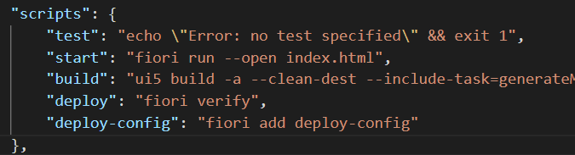
Adding deployment Configuration to App
Steps to configure the Application to deploy the Application on ABAP Environment.
Open the terminal in BAS or VS Code and go to your project folder.
Open terminal in you project folder.
Write command ui5 build or npm run build and press enter to build your project it will create a dist folder.
Now write command npx fiori add deploy-config to configure the project for deployment.
Select a target ABAP system … http://103.227.221.222 in your case your hostname will come in this step.
Enter the ABAP system client number …
Enter a username …
Enter a password …
Enter an application name …
Enter a description for the application …
Enter a package for the deployed application … $TMP
Now to deploy the application to the ABAP repository we use the command npm run deploy.

Slide 6
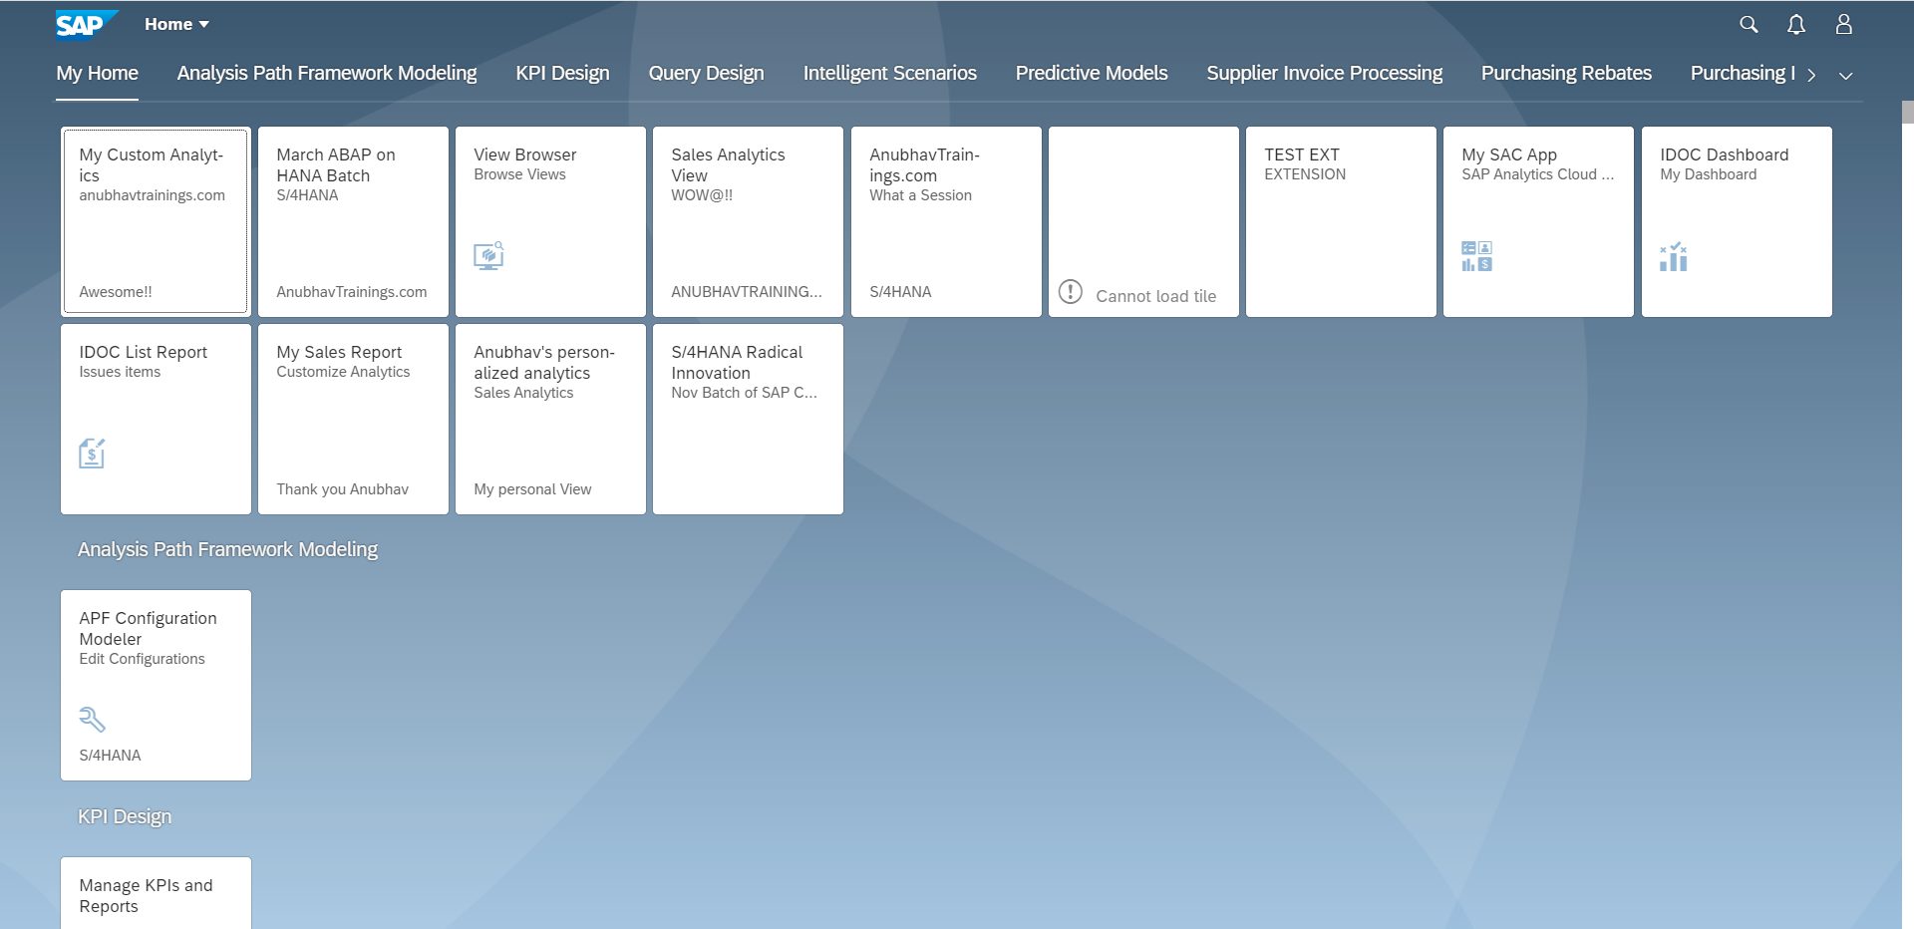
Fiori Launchpad
SAP Fiori Launchpad is a single access point for all the Applications in S/4HANA. Is available fiori frontend server once Fiori is installed in your SAP System.
The SAP Fiori launchpad is a shell that hosts SAP Fiori apps, and provides the apps with services such as navigation, personalization, embedded support, and application configuration.
The launchpad is the entry point to SAP Fiori apps on mobile and desktop devices. The launchpad displays a home page with tiles.
Each tile represents a business application that the user can launch. Tiles can also display live status indicators, such as the number of open tasks.
The launchpad is role-based. In other words, the user’s role determines which app tiles are shown.
Launchpad comes with Launchpad Designer (LPD), which allows developer/consultant to configure access to the apps as a Tile.
The TCode to access:
Launchpad: /N/UI2/FLP
Launchpad Designer: /n/UI2/FLPD_CONF

Slide 7
Why we require Launchpad
Just imagine, if my co. have developed 500 Apps in last Quarter, These 500 apps have got 500 URLs to access the app. As a end user, you would face below challenges
Finding URL for each app is a challenge
Making sure that you are right person to access app – Security
Also you should only be able to see apps which you are allowed to access
SAP Portal is now deprecated, what options do we have to access all functionality of ERP
Type of Fiori App Implementation
There are two types of Fiori App Implementations: Standard Apps and Customized Apps.
Standard Applications
Customized Apps
Implementation of those business apps, which are released by SAP
These are categorized as Transnational, Fact-sheets and Analytical apps etc.
As per business requirement, a complete custom fiori app can be implemented.
Customized App is been hosted on SAP-Fiori server (front-end system).
It integrates with SAP or Non-SAP system.

Slide 9
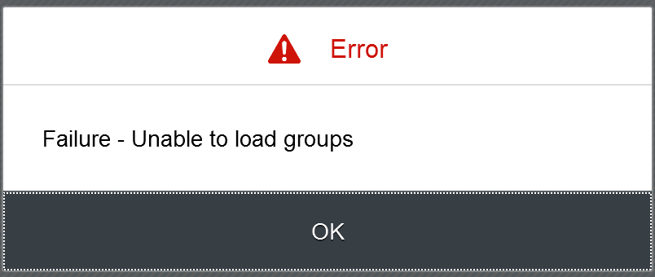
Fiori Launchpad Access
The service which is used by Launchpad to run
/UI2/INTEROP – This service controls navigation from tile to the Application
/UI2/PAGE_BUILDER_PERS – Launchpad personalization, Used to load all the tiles, groups of users, controls the loading of launchpad content for our users.
Trouble shooting:
The service is not even registered
The service is not even activate
You may not have authorization to access this service.

Slide 10
Basic Terms related to the Launchpad
Catalog – A Collection of all the Tiles, Each tile represent precisely one Application. We create catalog to package all tiles together according to team, functional area, application component, functionality, area of responsibility…
Tile – a square box which provides entry point for an app, it consists of 2 parts,
Tile Properties – title, subtitle, icon, ..
Intent - Semantic Object + Action
Semantic Object – The business object which is involved in the activity. Area of interest. E.g. SalesOrder, PurchaseOrder, OutboundDelivery, Customer, Vendor, Sales,..
Action – Define the purpose of our Fiori Application. Indicative of the Activity which we want to perform on Business object. E.g. Create, Change, Manage, Track, Maintain, Execute, Analyze
Intent ➔ SalesOrder-manage, OutboundDelivery-track
Note: Every application in entire system has unique intent.
3. Target Mapping – Maps the intent with the actual Fiori App, WeBGUI, Tcode, Webdynpro App.
4. Group – Is used to group tiles logically from business point of view, We never create tiles in group. We reference tiles in the group from catalog.
5. Role – A user will be granted a role and inside the role we will have the catalog and the group.
intent
Tile
Tile 1
Fiori App
Tile
Tile 2
Target Mapping

Slide 11
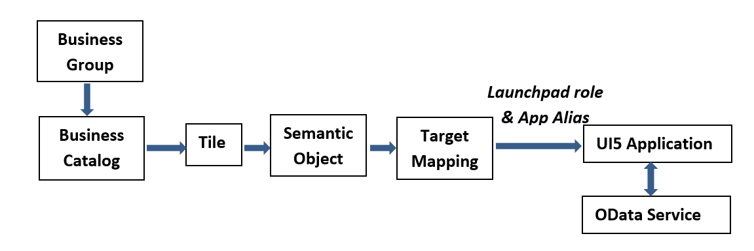
Relationship between Front-End Components

Slide 12
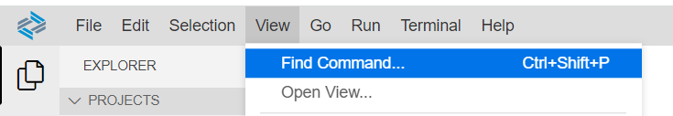
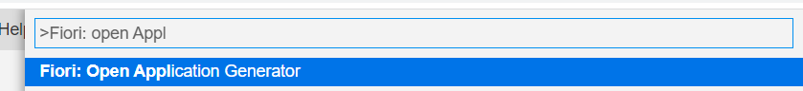
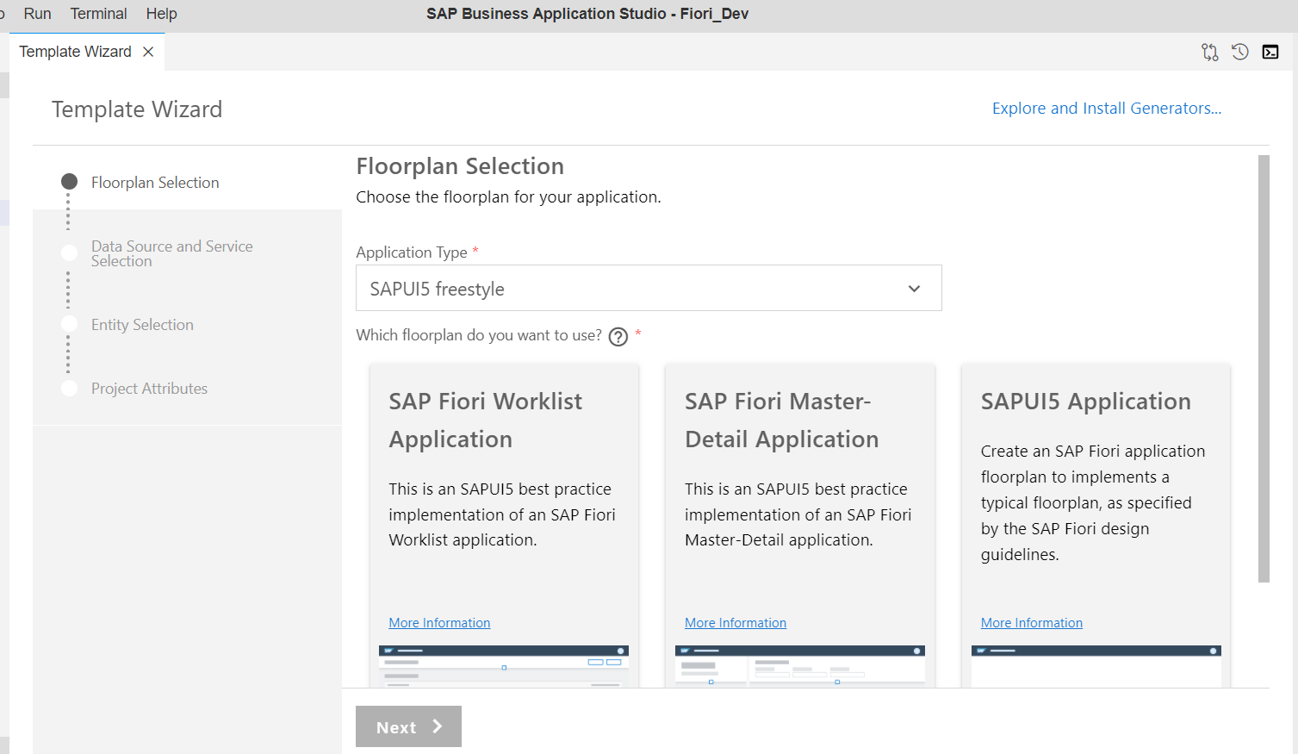
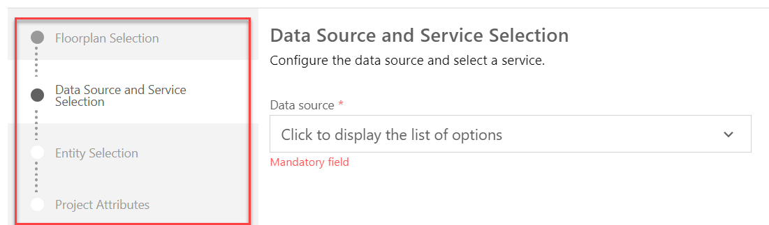
Creating Fiori App with Template in BAS
Steps to create a project using template in BAS.
Step 1: Click on the View tab and open the command pallet.
Step 2: In command pallet search for >Fiori: Open Application Generator and Select it.
Step 3: After Selecting it A new Template wizard will open. In the template wizard select the type of application and floorplan of the application and follow the configuration steps.
Step 4: Configure the Data Source and Service. Add the required Project attributes and Finish then your application will be generated.

Slide 13
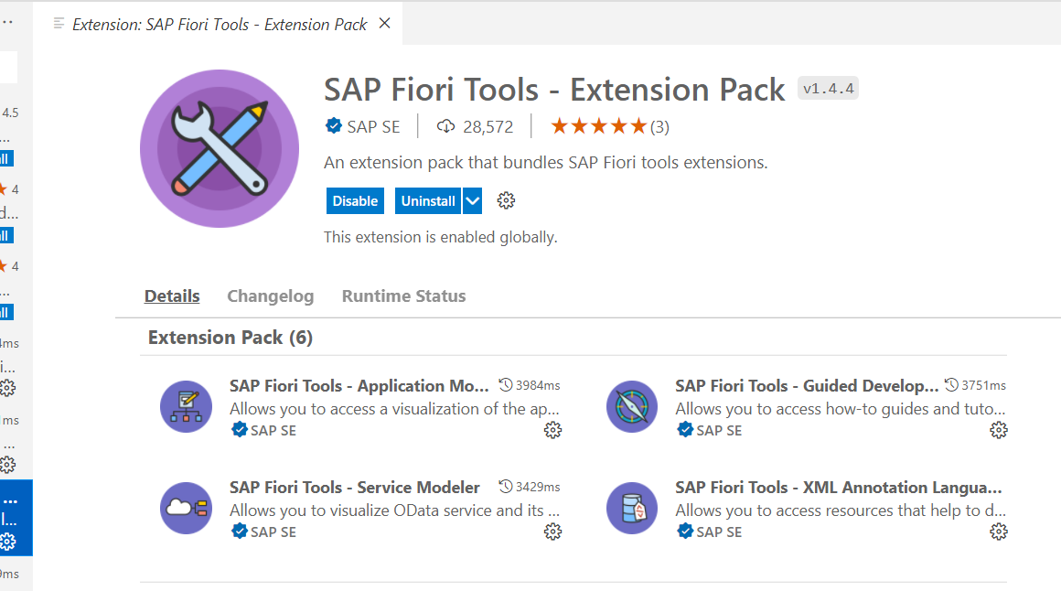
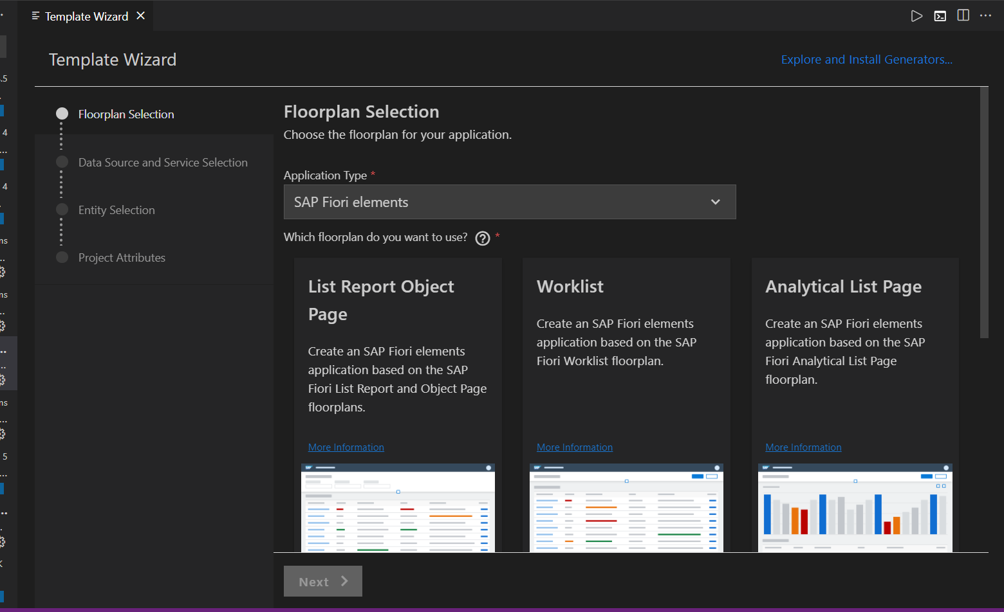
Creating Fiori App using Template in VS code
Before we start generating application in VS code, we need to verify that Fiori Tools are installed in our system or not. To do that we need to install an extension pack in VS code, which is SAP Fiori Tools – Extension Pack.
Once the installation of extension pack is completed, we can follow the same steps which are specified in the previous slide. In which we have generated the application using template in BAS.
When we open the Template Wizard in VS Code then, we will see a similar screen which we have seen in the BAS.

Slide 14
Fiori = UX Consistency
UX consistency
▪ Increases adoption of your app
▪ Improves business user productivity
▪ Decreases training time
▪ Improves data quality
▪ Enhances user satisfaction
SAP Fiori elements provides standard floorplans and uses metadata to streamline and accelerate developing SAPUI5 applications.
SAP Fiori elements
▪ Delivers enterprise-ready SAPUI5 apps based on
stable, optimized, out-of-the-box UI code
▪ Boosts developer efficiency by scaling development
and maintenance in a cost-efficient way
▪ Provides a centrally managed, consistent UX
complying with the latest SAP Fiori design
▪ Ensures upgrade stability and forward compatibility
▪ Allows extensibility of standard floorplans with custom
controls and logic

Slide 15
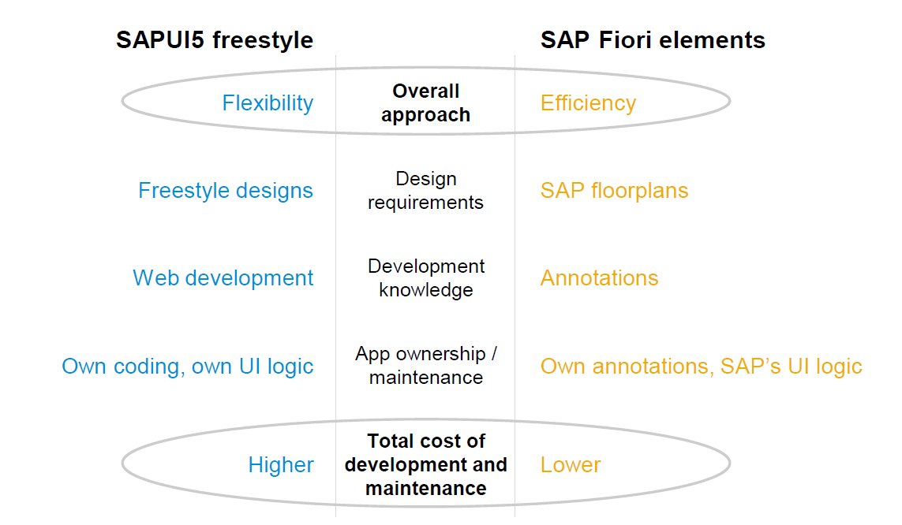
Free Style v/s Fiori Elements Apps

Slide 16
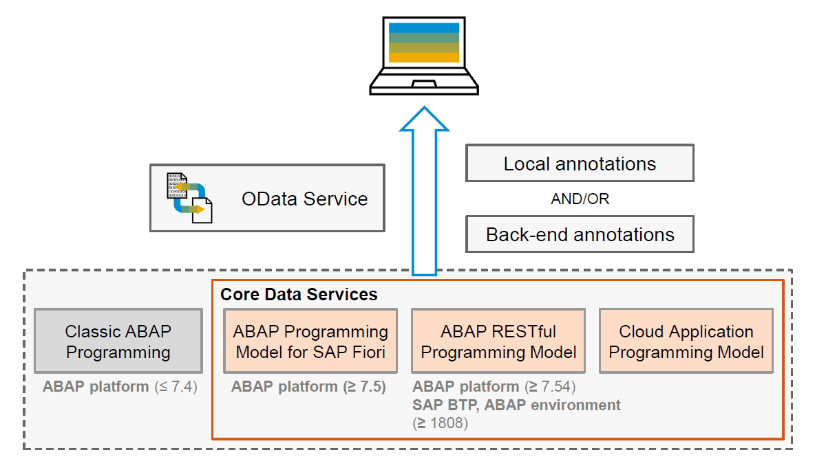
Big Picture – Architecture

Slide 17


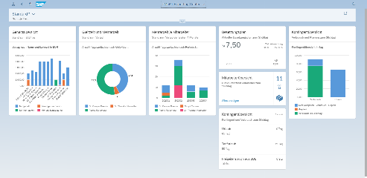





Developer Persona – Fiori Elements
Anubhav
Happy User
Rob
S/4HANA Technical consultant
ABAP Developer
Roxana
UX Designer | Fiori Developer
ABAP Dev. Tools
On
Eclipse
VS Code
BAS
OData Service
Fiori Elements Project
Annotations.xml
CDS Views
MDE
@

Slide 18
Annotations
Annotations are additional metadata and provide abstract definitions of data semantics. These abstract definitions are stored in vocabularies from OData and SAP. SAP Fiori elements understand the annotations and generates the UI based on them.
CDS View Annotations
XML Annotations
Annotations which are coding in ABAP system.
Require experience in ABAP on HANA and done by an ABAP or S/4HANA Consultants
CDS annotations follow the lifecycle of your OData
Service.
Due to different release cycles, some new annotations
might be available later in ABAP CDS.
More suitable if we use frameworks like RAP, & BOPF to build end to end applications
Project will be coupled with OData built on CDS hence we cannot test application if the service is down.
Easy to code and can be modularized with metadata extensions in CDS.
Use ADT tool to code the same.
Coded inside the annotations.xml file inside a Fiori Application
Require understanding of XML in general and knowledge of annotations
XML annotations follow the lifecycle of your app (local project)
With latest UI5 release, we can use new features
Suitable if we use SEGW based services, Or other frameworks which does not support the annotations.
UI projects are decoupled from the CDS and services and can be tested and transported independently.
Easy to work with the help of annotation modeler extension pack
Use BAS or VS Code to develop same.

Slide 19
Fiori Elements - List Report Application
The list report offers powerful features for finding and acting on relevant data sets. It is often used as an entry point for navigating to the item details, which are usually shown on an object page.
List Report
Object Page

Slide 20
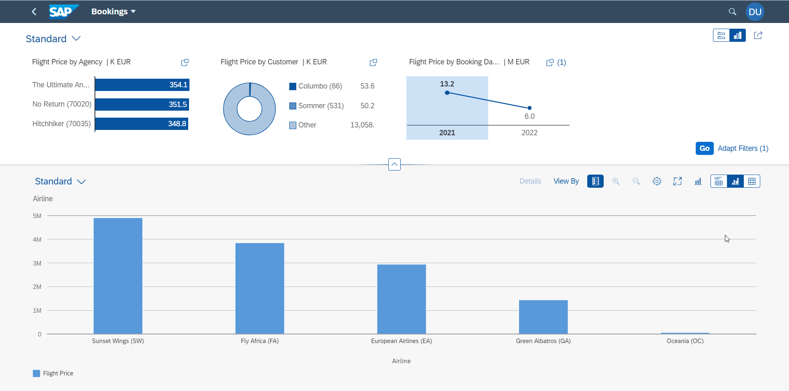
Fiori Elements - Analytic List Page
A ALP is used to display analytics as well as line item data in list. We can analyze data distribution across multiple dimensions for our measures. It also allows along with filter bar a special types of filter called visual filter.

Slide 21

End of Day 22

Slide 22

Questions

Slide 23

Anubhav Oberoy

Slide 24


We’re committed to empower you to be
Most Desirable Resource
through powerful training solutions.
We build the workforce of the future.
250+
Corporate Clients
30,000+
Learners Trained
25000+
Learners Placed
FREE WEBINARS
Sign up for free webinars with industry experts every fortnight!
Enroll Now!
Contact us today!
https://anubhavtrainings.com/

Slide 25




More from AnubhavTrainings.com

Slide 26
Title
Content

